Slide 1
Great Outdoors Group-B
By-
Ayush Agrawal
Abhishek Pratap Singh
Prafull Sharma
C Akhil Chowdary
Arshpreet
Sravani

Slide 2
Epic And User Stories
Return Online Order
Initialization of Return Order by Retailer
Validation of Product Id , Order Id and Quantity of Product
Selection of Purpose Of Return
Confirmation of Return of product by Retailer
Generate Return Id
Generating Return Reports for different purpose of return

Slide 3
Epic And User Stories
Sales Person Details
Adding, Updating , Deleting Sales Person Details
Generating Sales Person Id
Generating Sales Person Target Report for monthly ,Quarterly and Annually
Checking Status of Target met, not met or Exceeded.

Slide 4
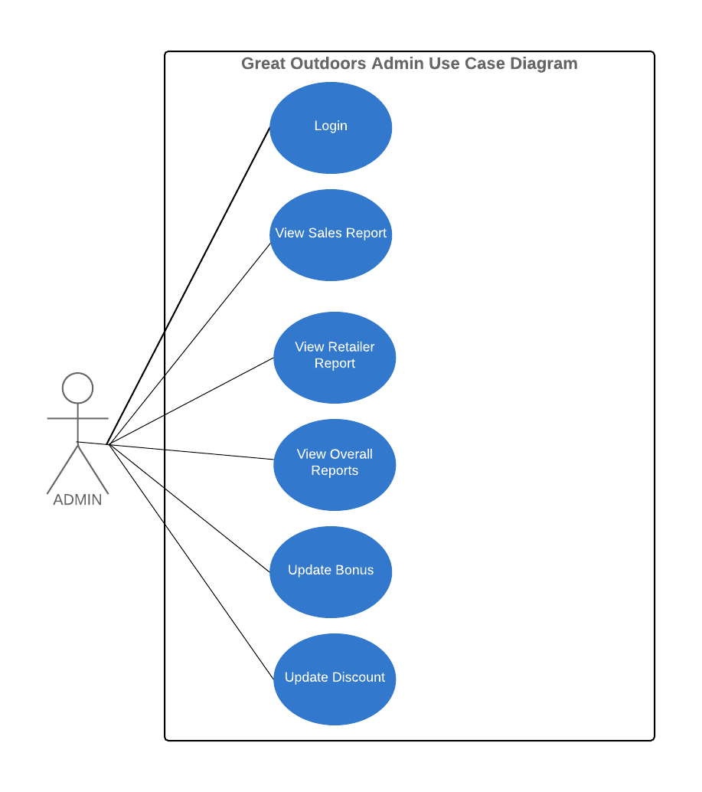
Use Case Diagram

Slide 5
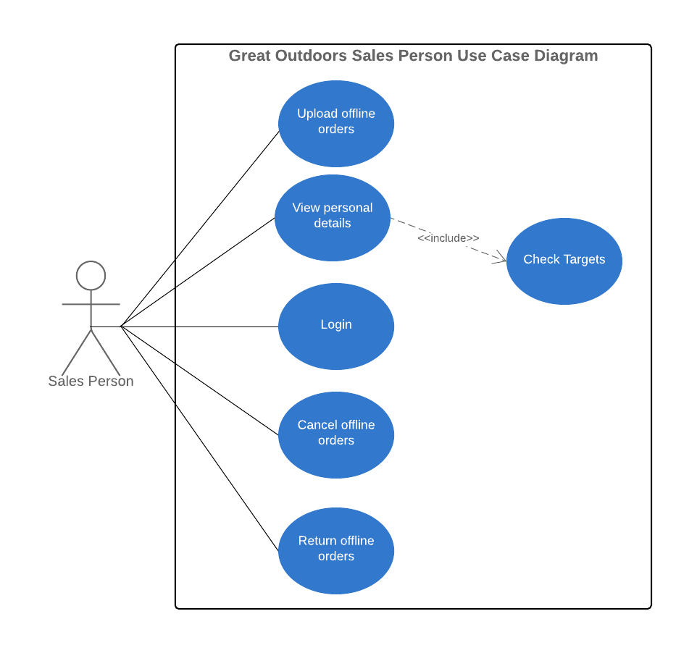
Use Case Diagram

Slide 6
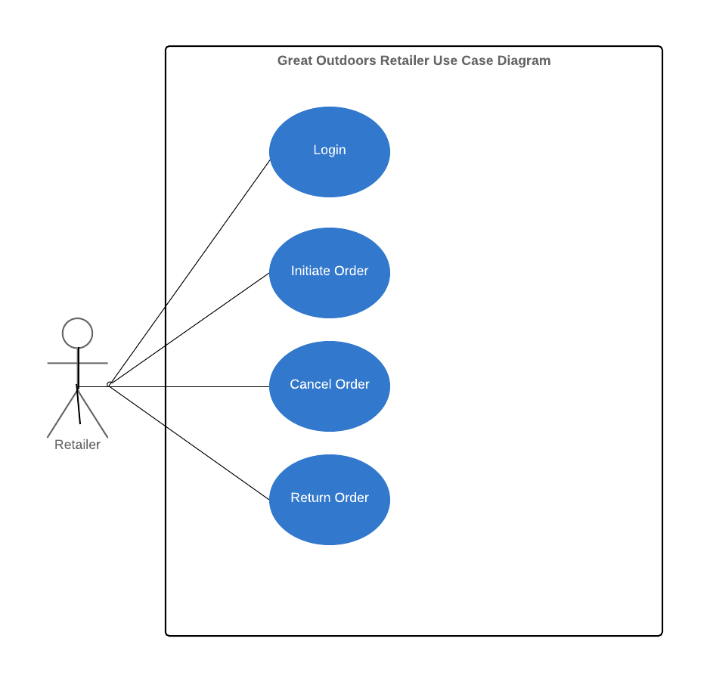
Use Case Diagram

Slide 7
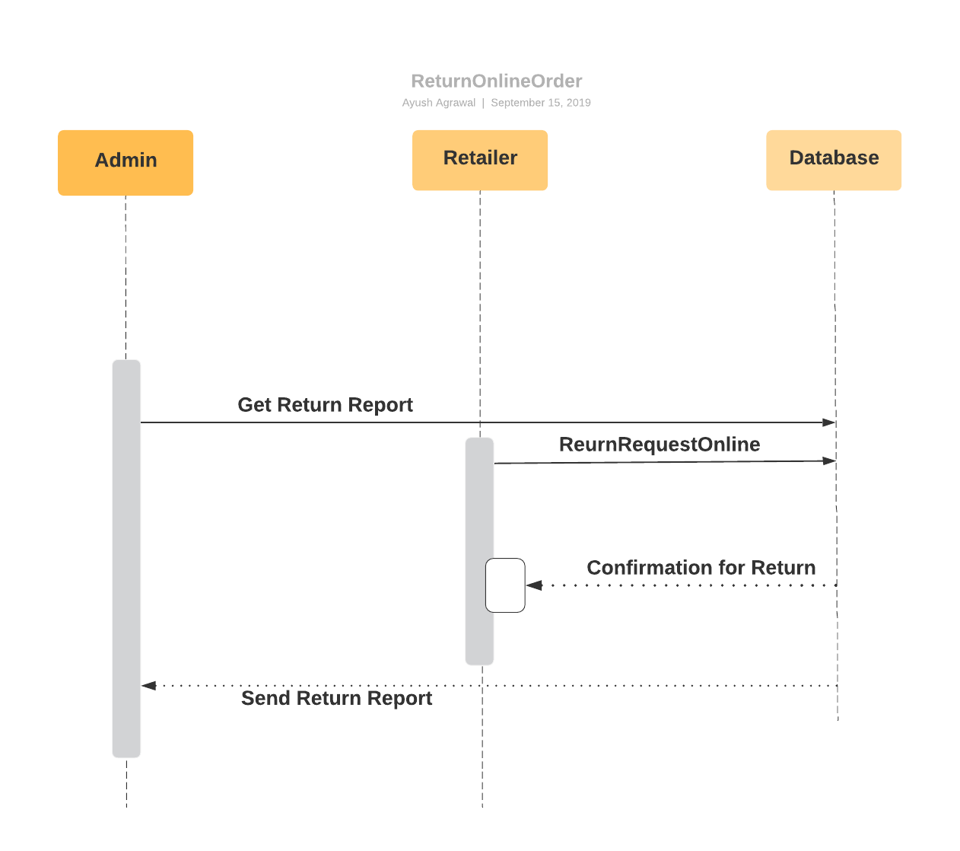
Sequence Diagram For Online Return Order

Slide 8
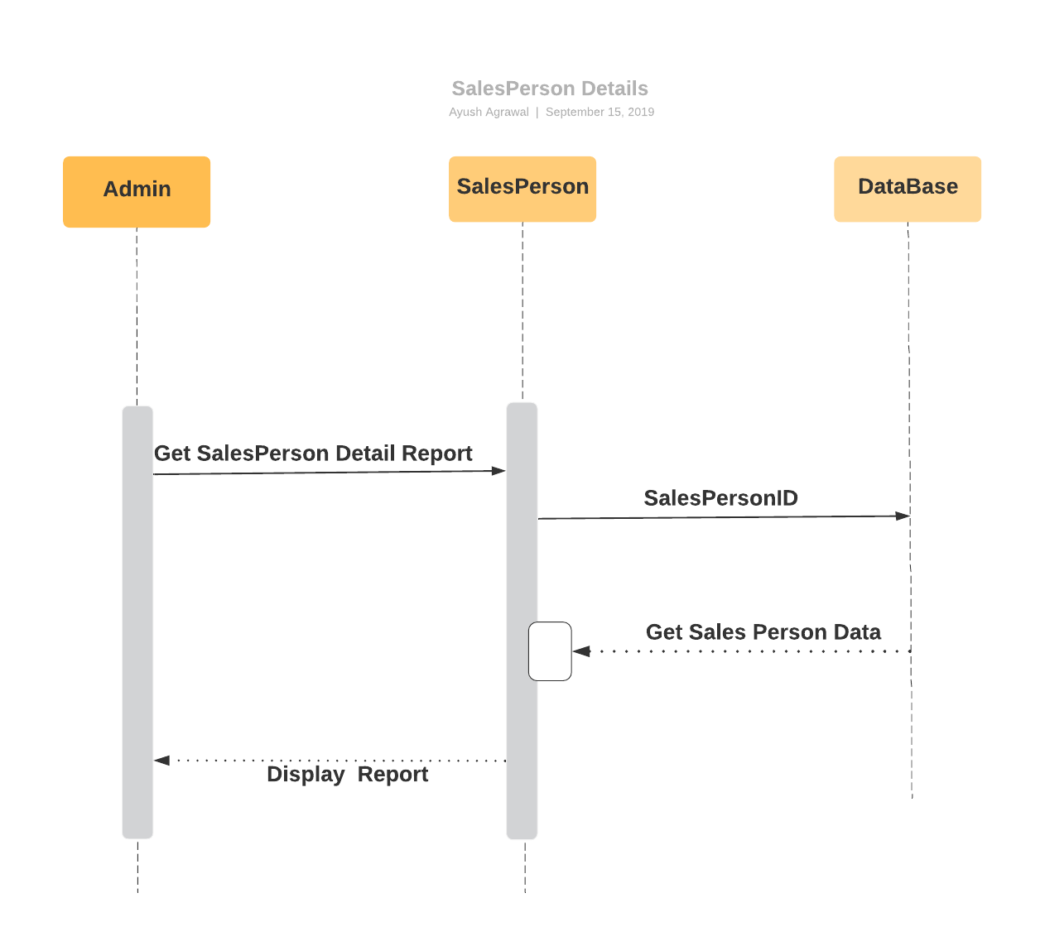
Sequence Diagram for Sales Person Details

Slide 9
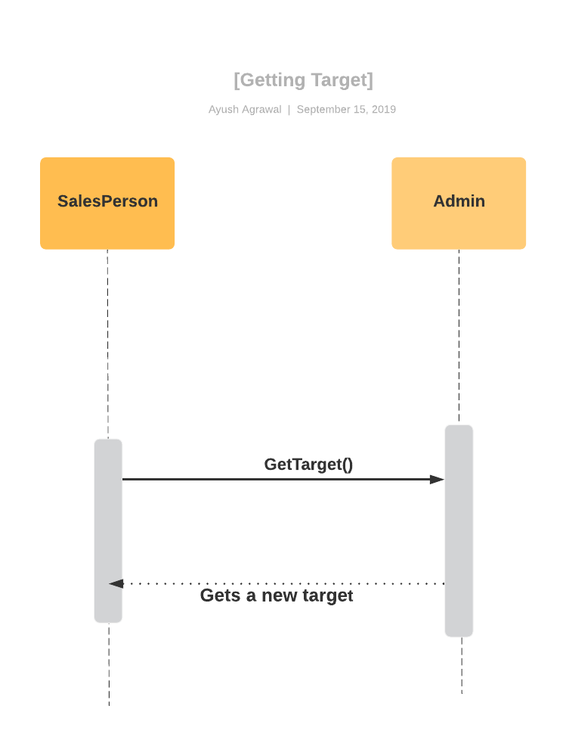
Sequence Diagram For Getting Sales Target By Sales Representatives

Slide 10
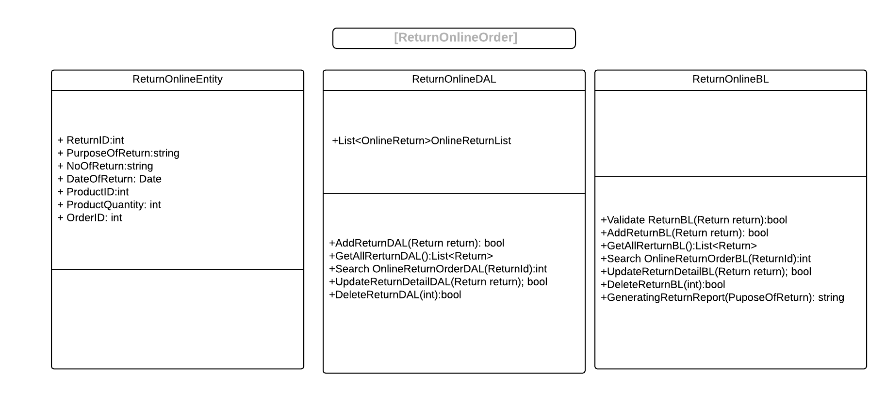
Class Diagram

Slide 11
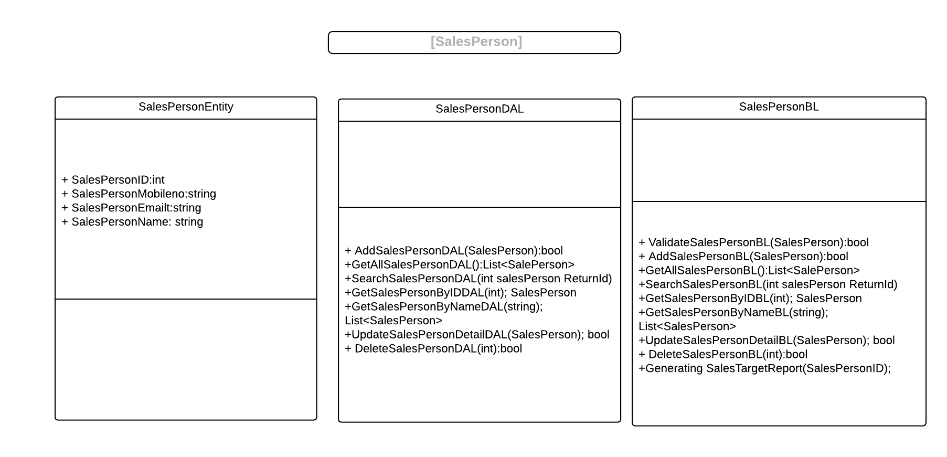
Class Diagram

Slide 12
Thank you

